Slide 1
One-Dimensional Equations of Motion
Dr. Jacob Moore
Associate Professor of Engineering
Penn State Mont Alto

Slide 2
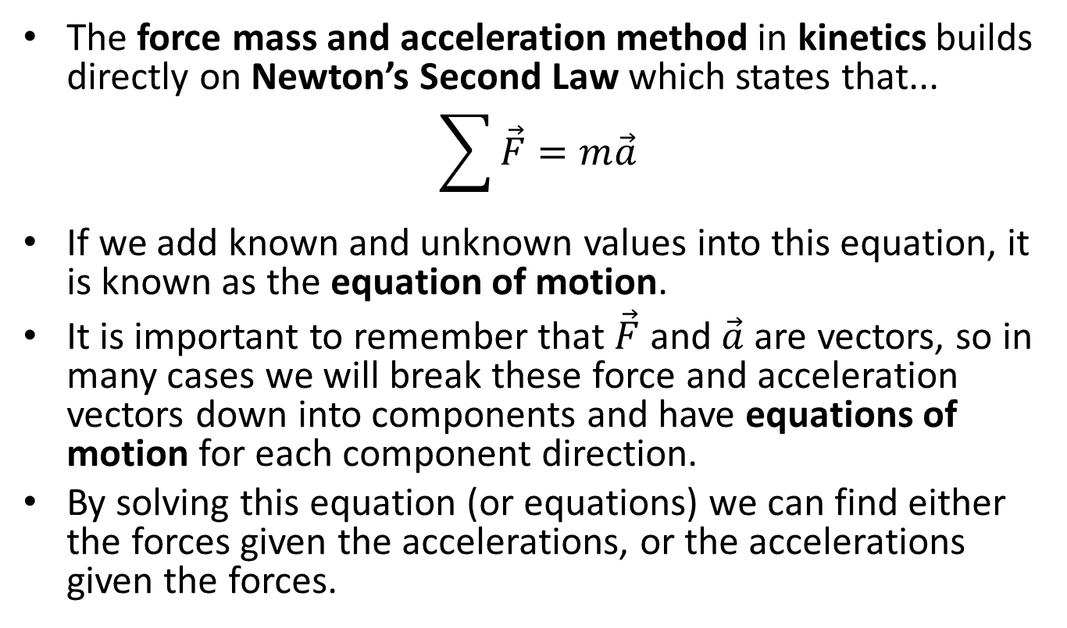
Newton’s Second Law and the Force Mass and Acceleration Method
The force mass and acceleration method in kinetics builds directly on Newton’s Second Law which states that...
$$\sum{\vec{F}}=m\vec{a}$$
If we add known and unknown values into this equation, it is known as the equation of motion.
It is important to remember that $\vec{F}$ and $\vec{a}$ are vectors, so in many cases we will break these force and acceleration vectors down into components and have equations of motion for each component direction.
By solving this equation (or equations) we can find either the forces given the accelerations, or the accelerations given the forces.

Slide 3
Force Method in One Dimension
We will start by examining the motion in a single direction.
When only one direction of motion is possible, we can only use only a single equation of motion to solve for unknowns at a given instant in time.
$$\sum{F_{x}=ma_{x}}$$

Slide 4
Force Method in One Dimension
We will ignore any forces (or force components) not in in the direction we are examining.
y
F_{g}
Mass = m
F_{x}
a_{x}
x
F_{N}

Slide 5
Newton’s Second Law Over Time
The original equation will relate the force, mass, and acceleration at a given instant in time.
$$\sum{F_{x}=ma_{x}}$$
If we look beyond a given instant, modeling the force over time and acceleration over time however, we can still use Newton’s Second Law to relate the force and acceleration.
$$F_{x}\left(t\right)=m a_{x}(t)$$
Though mass is usually constant for a given body, in rare instances it may also be changing over time.

Slide 6
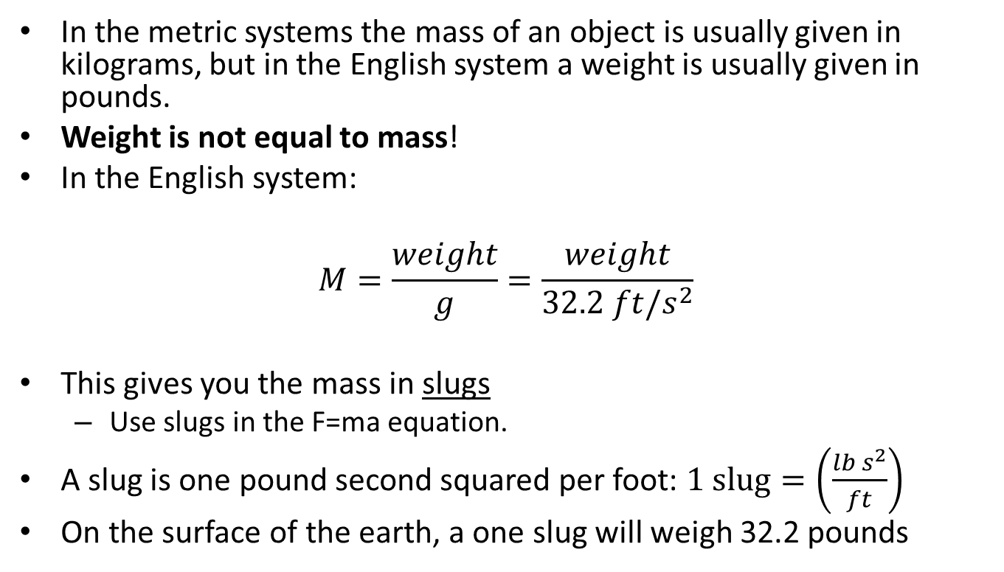
Mass (be careful)
In the metric systems the mass of an object is usually given in kilograms, but in the English system a weight is usually given in pounds.
Weight is not equal to mass!
In the English system:
$$M=\frac{weight}{g}=\frac{weight}{32.2 ft/s^{2}}$$
This gives you the mass in slugs
Use slugs in the F=ma equation.
A slug is one pound second squared per foot: $1 slug=\left(\frac{lb s^{2}}{ft}\right)$
On the surface of the earth, a one slug will weigh 32.2 pounds

Slide 7
Solving a Kinetics Problem (The Process)
The process used in solving a kinetics problem is similar to solving a problem in statics and consists of three steps.
Set up a free body diagram.
Draw the body separated from it’s surroundings
Draw in all the known and unknown forces (I use red for forces) as well as key dimensions and angles (I use blue for dimensions and angles)
Draw in the acceleration vector (I use a blue dashed vector for this)
Use the free body diagram to write out your equation(s) of motion.
Solve the equation(s) of motion for any unknowns.

Slide 8
Thanks for Watching
See other engineering mechanics videos and access the full tool at…

Slide 9
Worked Example
A 90 lb block sits on a smooth surface as shown below. If a 50 lb force is applied as shown below...
What is the rate of acceleration of the block?
What is the velocity and displacement three seconds after the force is applied?
y
90 lbs
50 lbs
x

Slide 10
Worked Example
Repeat the procedure for the same block on a surface with a coefficient of friction of $μ=.2$
What is the rate of acceleration of the block?
What is the velocity and displacement three seconds after the force is applied?
y
90 lbs
50 lbs
x

Slide 11

Worked Example
An 2000lb elevator decelerates a from a speed of 25 ft/s downward to a stop in a distance of 50 ft.
Determine
The rate of deceleration (assuming a constant rate)
The tension in the cables supporting the elevator during this period.

Slide 12

Worked Example
A rocket test sled is being used test a solid rocket booster (m=1000kg). It’s known that generally a solid rocket booster’s force will fit the equation a F= A + Bt – Ct². If the rocket has an initial thrust of 10 kN, and achieves a speed of 150 m/s and travels 700m during a 10 second test run, determine the constants A, B and C for the rocket.

